Slide 1


Manu Raj
Olympic Data
ANALYSIS

Slide 2

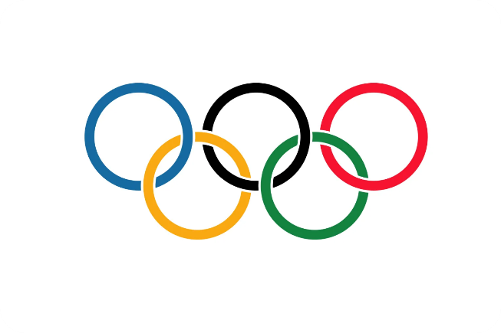
Started in ancient Greece in 776 BCE, honoring Zeus with sports like running and wrestling.
Olympic
HISTORY
Modern Olympic started in 1896
Helds every 4 years
Evolved to include a wide range of sports, reflecting global athletic diversity and interests.
The Olympics is a premier global sports event where athletes from around the world compete in various disciplines. It fosters unity, sportsmanship, and friendly competition among nations, showcasing the pinnacle of athletic excellence and cultural diversity on an international stage every four years.
The five interlocking rings represent the five continents of the world
There are 4 types of Olympics
Summer, Winter, Youth, Paralympic
France will host the 2024 Olympics

Slide 3

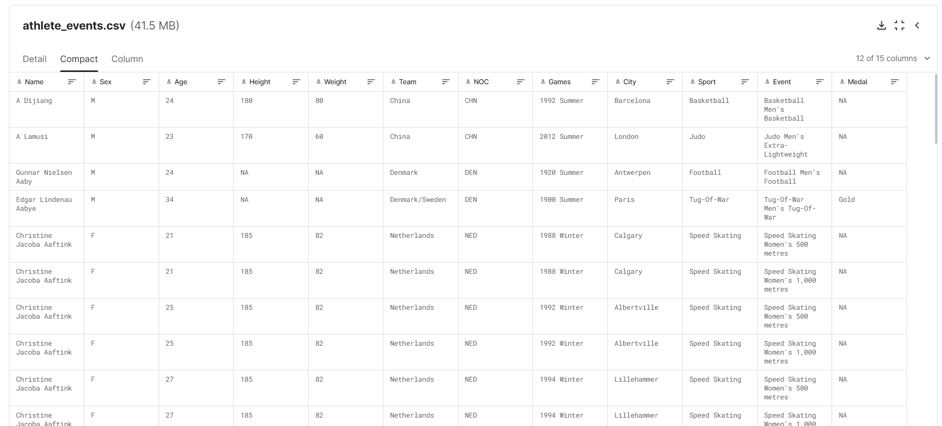
Data Source
KAGGLE
1896-2016
01
02
03
04
Briefly describe the concept
Briefly describe the concept
Briefly describe the concept
Briefly describe the concept
05
06
07
08
Briefly describe the concept
Briefly describe the concept
Briefly describe the concept
Briefly describe the concept

Slide 4

Dashboard has 4 modules
01
Overall Analysis
02
Medal Tally
Comprehensive Olympic insights spanning decades
Medal distribution across nations and sports.
03
Country Wise Analysis
Athlete Wise Analysis
04
Country-specific Olympic performance insights.
Athlete-focused age-to-sport probability analysis.

Slide 5
LET’S SEE THE DASHBOARD

